Slide 1
SLM Studio: Governed, AI-First SLM Fine-Tuning Delivery
Why it matters: turns ad-hoc small-language-model tuning into a repeatable, evidence-gated production path.
THE ENTERPRISE PROBLEM
REUSABLE, NOT GENERIC
TOKEN ECONOMICS
Frontier-LLM FAQ workload: 120–140K req/day, ~6B GPT tokens/mo, ~$162K/mo
Reported by CTS — evidence required for independent verification
Ad-hoc fine-tuning projects rebuild data checks, prompts and tests each time — no lineage, no release gate
Available — executable, versioned pipeline: 5 governed stages, not a tutorial
Task-portable: swap dataset builder + prompt contract; keep the SFT/eval/release engine
Governance first-class: leakage-free splits, managed-identity training, sealed-test eval, human-approved release, PSI drift monitor
Available — every inference call logs generated-token count + latency per model
Release/deployment gates require answer token-F1 ≥ 0.70 plus a latency budget
AI-first delivery, CTS-evidenced: 2-model, 5-metric evaluation in ~32 hours using these accelerators
Roadmap — “token yield” (grounded-answer quality per generated token) is proposed, not yet computed
Notes:
Claim support:
- 5 governed stages 01-05, task-portability, governance-first design: README.md ("Why this repository", Workflow table).
- Leakage-free splits, fingerprint, managed-identity training, sealed-test eval, PSI drift: README.md; lib/data.py; lib/monitoring.py.
- Generated-token count + latency captured per model per record: lib/inference.py (prompt_token_count, *_generated_token_count, *_latency_ms fields).
- Release/deployment token-F1 gate >= 0.70: lib/release.py (ReleasePolicy.min_token_f1, DeploymentPolicy.min_token_f1).
- 'Token yield' is a proposed framing, not an implemented metric anywhere in the repo - labeled Roadmap.
- CTS workload scale (120-140K req/day, 6B tokens/mo, $162K/mo) and the ~32-hour 2-model evaluation claim: docs/1C_Assist_FAQ_Eval_Report.pptx (Slide 2 'Reported usage and cost'; Slide 3 Executive Summary). These are CTS-reported figures, not measured by SLM Studio - labeled accordingly.

Slide 2
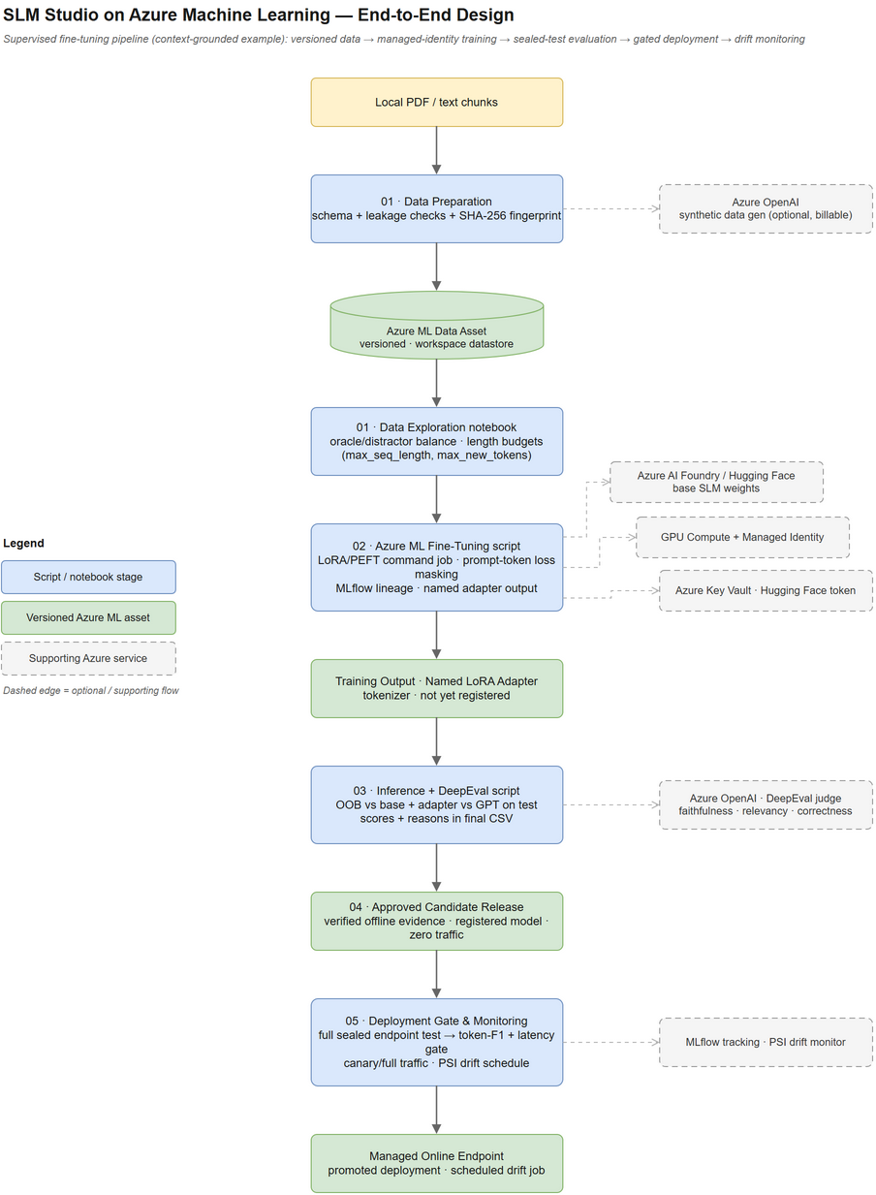
What's Built: A Five-Stage, Script-Orchestrated Release Pipeline
Reusable components in lib/ drive every stage; scripts/ orchestrate state changes; notebooks are read-only exploration.
AUTOMATED IN CODE
Available — 01 Prepare + version — leakage-free splits, SHA-256 fingerprint, Azure ML data asset
02 Fine-tune LoRA — Unsloth/PEFT, prompt-token loss masking, managed-identity job
03 Compare + judge — OOB vs fine-tuned vs cached GPT baseline, DeepEval RAG judge
04 Approve + register — human approval, zero-traffic deploy, drift baseline
05 Gate + monitor — token-F1/latency gate, canary/full traffic, scheduled PSI drift
GOVERNANCE, REUSE & EVIDENCE
Release gate: faithfulness/relevancy/correctness ≥ 0.70, ≥ 30 examples, p95 latency ≤ 40s
14 automated pytest modules cover gates, drift, lineage and dataset validation
Available (demo) · In progress (production wiring) — local UI wizard mirrors the 5 stages; read-only Azure evaluation snapshot
Source: docs/architecture.drawio → docs/architecture-png.png
Notes:
Claim support:
- Stage table (01-05), outputs/dependencies: README.md Workflow table; scripts/01_prepare_data.py .. scripts/05_deployment_gate.py.
- Leakage-free grouped splits + fingerprint: lib/data.py. LoRA via Unsloth + prompt-token loss masking: README.md 'Azure ML Fine-Tuning'; lib/train.py.
- OOB vs fine-tuned vs GPT baseline + DeepEval judge: lib/inference.py; lib/deepeval_metrics.py; lib/llm_baseline.py.
- Human approval, zero-traffic deploy, drift baseline, token-F1/latency gate, canary/full traffic, scheduled PSI: lib/release.py; lib/drift_schedule.py; lib/monitoring.py.
- Release thresholds (>=0.70 faithfulness/relevancy/correctness, >=30 examples, p95<=40000ms): lib/release.py ReleasePolicy/DeploymentPolicy defaults.
- 14 automated test modules: tests/ directory listing (test_release.py, test_monitoring.py, test_evaluation.py, etc.).
- Local demo wizard mirrors 5 stages; read-only Azure evaluation snapshot, no production Azure calls: app/README.md.
- Architecture diagram: docs/architecture-png.png (source docs/architecture.drawio).

Slide 3
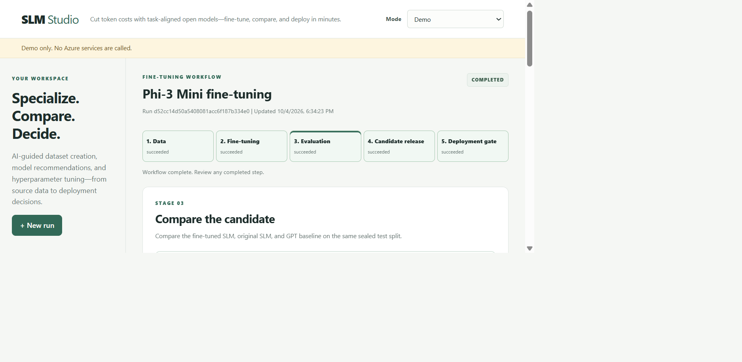
Next: UI Studio Roadmap | Proof: CTS 1C Assist Evidence
Appendix-style evidence: the governed pipeline is proven in code; the guided production UI and $ savings are next.
UI STUDIO — NOW + NEXT
CTS · 1C ASSIST UAT EVIDENCE (n=712)
Available — 5-stage local demo wizard (I-01) + read-only Azure evaluation snapshot, 75 sealed-test records
Roadmap — I-02 Gate/registration → I-03 Data/training → I-04 Comparison → I-05 Deployment/monitoring (all “not started”)
Output format correctness: 39.0%→91.6% (+52.5 pp, 3B) · 29.2%→97.9% (+68.7 pp, 8B)
Faithfulness: +10.6 pp (3B) · +9.3 pp (8B) vs out-of-box baseline
Citation correctness: +44.1 pp (3B) · +11.4 pp (8B) vs out-of-box baseline
AI-first delivery, CTS-evidenced: 2-model, 5-metric evaluation completed in ~32 hours using these accelerators
Evidence required — engineering-hours and $ serving-cost savings are not quantified in this UAT; the “~80–90% reported savings” and “$162K/mo” figures are CTS-reported, not independently measured by SLM Studio
Demo UI: app/ (localhost only, no Azure calls)
Notes:
Claim support:
- UI Studio current scope (demo-only, 5-stage wizard, read-only Azure evaluation snapshot, no Azure calls at runtime): app/README.md.
- 75 sealed-test records in the bundled evaluation snapshot: app/data/evaluation_showcase.json, generated by scripts/export_evaluation_showcase.py; screenshot captured live from the running app (http://127.0.0.1:8000/).
- Incremental roadmap I-01..I-05, each 'not started' except I-01: docs/ui-layer-plan.md Section 7 'Incremental delivery'.
- UAT n=712 and per-metric GPT/OOB/fine-tuned scores for LLAMA-3.2-3B and LLAMA-3.1-8B: docs/1C_Assist_SLM_Baselines.xlsx, 'Summary' and 'RAW_Scores' sheets (Stage 2: Finetune SLM Evaluation, dated 2026-09-26/29).
- Percentage-point deltas (e.g. Output Format Correctness +52.5pp/+68.7pp, Faithfulness +10.6pp/+9.3pp, Citation Correctness +44.1pp/+11.4pp): computed directly from the 'Abs Uplift vs OOB (pp)' columns in the same Summary sheet.
- ~32-hour 2-model evaluation and AI-first delivery framing: docs/1C_Assist_FAQ_Eval_Report.pptx, Slide 3 Executive Summary (text only; no slide image reused).
- Reported usage/cost and ~80-90% savings figure, flagged as CTS-reported/not independently measured: docs/1C_Assist_FAQ_Eval_Report.pptx, Slide 2 'Reported usage and cost' (text only).

